Slide 1
X Education - Lead Scoring Case Study
Identification of Hot Leads to focus more on them and thus enhancing the conversion ratio for X Education
Prepared by: Md Nisar Ansari

Slide 2
Background | X Education Company
X Education , An education company named sells online courses to industry professionals
Many interested professionals land on their website
The company markets its courses on several websites like Google. Once these people land on the website, they might browse the courses or fill up a form for the course or watch some videos
When these people fill up a form providing their email address or phone number, they are classified to be a lead
Once these leads are acquired, employees from the sales team start making calls, writing emails, etc. Through this process, some of the leads get converted while most do not
The typical lead conversion rate at X education is around 30%
Problem Statement
X Education gets a lot of leads but its lead conversion rate is very poor
To make this process more efficient, the company wishes to identify the most potential leads, also known as ‘Hot Leads’
If they successfully identify this set of leads, the lead conversion rate should go up as the sales team will now be focusing more on communicating with the potential leads rather than making calls to everyone
We will help them to select the most promising leads, i.e. the leads that are most likely to convert into paying customers.
We are required to build a model wherein we need to assign a lead score to each of the leads such that the customers with higher lead score have a higher conversion chance
The CEO, in particular, has given a ballpark of the target lead conversion rate to be 80%.

Slide 3
Lead – Conversion Process
Lead Generation:
1. Ads on websites like Google
2. Referrals
Visit to X Education website by these potential customers (professionals)
Visitors either provide Email id & Contact Details
Or
View videos etc
Tele calling and Emailing activity to all the leads
~30% leads get converted
Lead to Conversion process
Proposed Solution:
A model to filter leads so that leads to conversion ratio is 80%+

Slide 4
Proposed Solution
Selection of Hot Leads
Communicating with Hot Leads
Conversion of Hot Leads
Leads Clustering
We cluster the leads into certain categories based on their tendency or probability to convert, thus, getting a smaller section of hot leads to focus more on.
Focus Communication
Since we would have a smaller set of leads to have communication with, we might make more impact with effective communication.
Increase conversion
Since we focussed on hot leads, which were more probable to convert, we would have a better conversion rate, and hence we can achieve the 80% target.

Slide 5
Solution
For our Problem Solution, the crucial part is to accurately identify hot leads.
The more accurate we obtain the hot lead, the more chance we get of higher conversion ratio.
Since we have a target of 80% conversion rate, we would want to obtain a high accuracy in obtaining hot leads.
Selection of Hot Leads

Slide 6
Implementation

Slide 7
Loading & Observing the past data provided by the Company
Univariate, Bivariate, and Heatmap for numerical and categorical columns
Performing pre-requisites for RFE and Logistic Regression
Data Gathering
Data Cleaning
Performing EDA
Data Preparation
Model Building
Duplicate removal, null value treatment, unnecessary column elimination, etc.
Outlier Treatment, Feature-Standardization

Slide 8
Selection of top 25 features using RFE
Reduction of columns and Model re-building
Verifying our Final Model Accuracy etc. with model built with PCA
Feature Selection
Model Building
Model Improvement
Final Model
Verifying with PCA
Model building using RFE for selected columns
Final Model Analysis and performance on Test Data

Slide 9
Plots (Visualization)

Slide 10
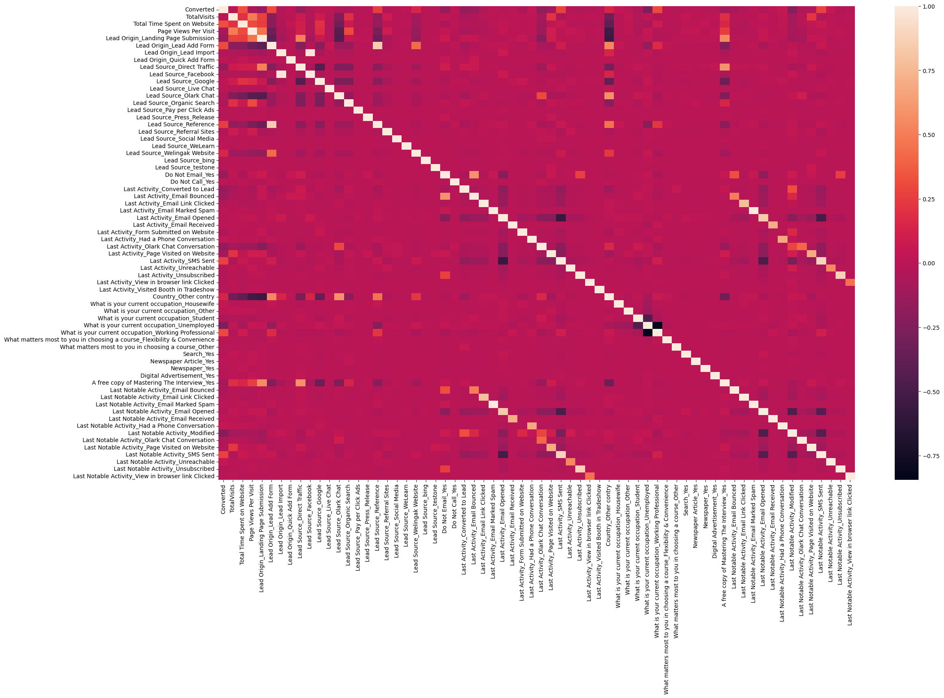
EDA plots depicting correlation (Heat Map) of all selected columns (numerical columns and dummy columns).

Slide 11
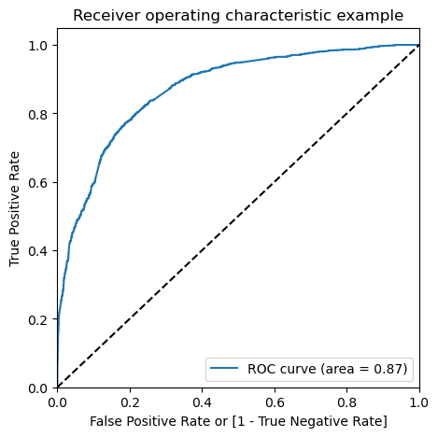
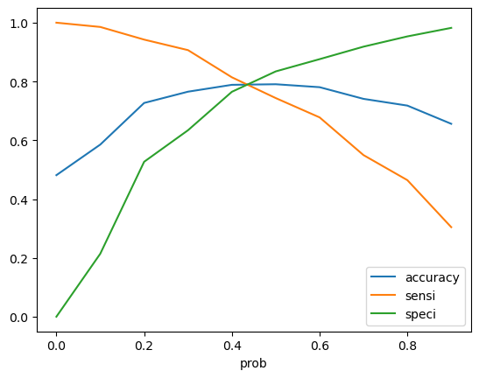
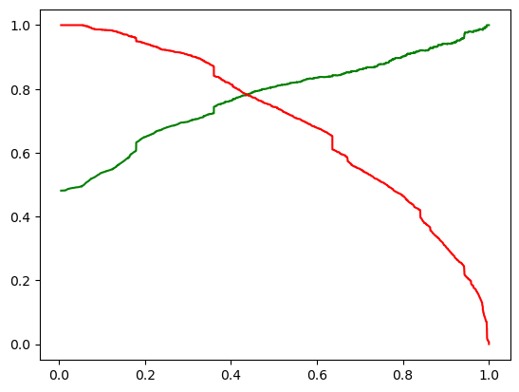
Linear Regression Final Model Parameters
Area under ROC = 0.87
Intermediate cut-off = 0.35
Final cut-off = 0.42

Slide 12
KEY TAKAWAYS
In the initial stage (top), there are many leads generated, but only a few become paying customers at the bottom.
The middle stage is crucial for nurturing potential leads through education and constant communication.
To increase lead conversion, identify the best prospects based on factors like 'TotalVisits,' 'Total Time Spent on Website,' and 'Page Views Per Visit.'
Maintain a handy list of leads and keep them informed about new courses, services, job offers, and future higher studies.
Monitor each lead closely and personalize the information sent to them based on their interests.
Tailor job offerings, information, or courses to match the individual interests of leads.
Develop a well-structured plan to address the specific needs of each lead.
Focus on converted leads and conduct question-answer sessions to gather relevant information.
Follow up with further inquiries and appointments to determine leads' intentions and willingness to join online courses

